Slide 1

Computer Network
Transmission Modes /Topologies

Slide 2

Computer Network

Slide 3
Computer Network
Network: A group or system of interconnected people or things.
Computer Network: The term computer network refers to two or more computer linked together so that they are able to exchange information.
A computer network is a set of connected computers.
Computers on a network are called nodes.
The connection between computers can be done via cabling (wired), most commonly the Ethernet cable, or wirelessly through radio waves.
Connected computers can share resources, like access to the Internet, printers, file servers, and others.

Slide 4
Uses of Computer
Resource Sharing: Printer, Data etc.
Communication Medium: People can communicate easily (email, Facebook, twitter etc.)
ecommerce: Online business

Slide 5
Advantages of Network
Speed
Accuracy
Stores huge amount of data
Online trading
Online education | Distance Learning
Research
Forecasting weather, and predicting earthquakes, volcano eruptions
Produce Employment
Internet
In Business

Slide 6
Types of Network

Slide 7
Types of Network
There are several different types of computer networks. Computer networks can be characterized by their size as well as their purpose.
The size of a network can be expressed by the geographic area they occupy and the number of computers that are part of the network.
Networks can cover anything from a handful of devices within a single room to millions of devices spread across the entire globe.
Some of the different networks based on size are:
Personal area network, or PAN
Local area network, or LAN
Metropolitan area network, or MAN
Wide area network, or WAN

Slide 8
Personal area network (PAN)
A personal area network, or PAN, is a computer network organized around an individual person within a single building.
This could be inside a small office or residence.
A typical PAN would include one or more computers, telephones, peripheral devices, video game consoles and other personal entertainment devices.
It allows you to:
Send a document to the printer in the office upstairs while you are sitting on the couch with your laptop.
Upload a photo from your cell phone to your desktop computer.

Slide 9
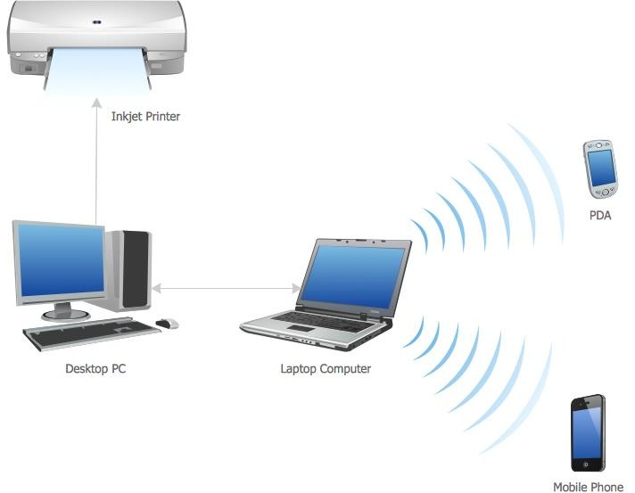
Personal area network (PAN)

Slide 10

Local area network (LAN)
A local area network, or LAN, consists of a computer network at a single site, typically an individual office building.
A LAN is very useful for sharing resources, such as data storage and printers.
LANs can be built with relatively inexpensive hardware, such as hubs, network adapters and Ethernet cables.
The smallest LAN may only use two computers, while larger LANs can accommodate thousands of computers.
A LAN typically relies mostly on wired connections for increased speed and security, but wireless connections can also be part of a LAN.
High speed and relatively low cost are the defining characteristics of LANs.

Slide 11
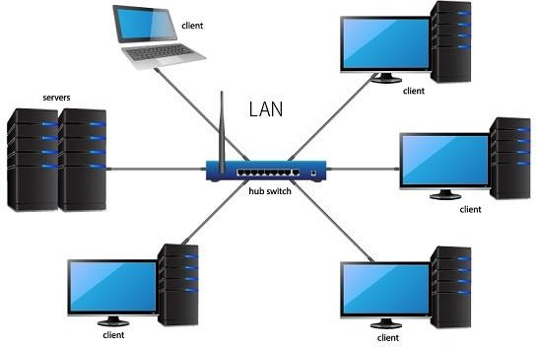
Local area network (LAN)

Slide 12
Metropolitan area network (MAN)
A metropolitan area network, or MAN, consists of a computer network across an entire city, college campus or small region.
A MAN is larger than a LAN, which is typically limited to a single building or site.
Depending on the configuration, this type of network can cover an area from several miles to tens of miles.
A MAN is often used to connect several LANs together to form a bigger network.

Slide 13
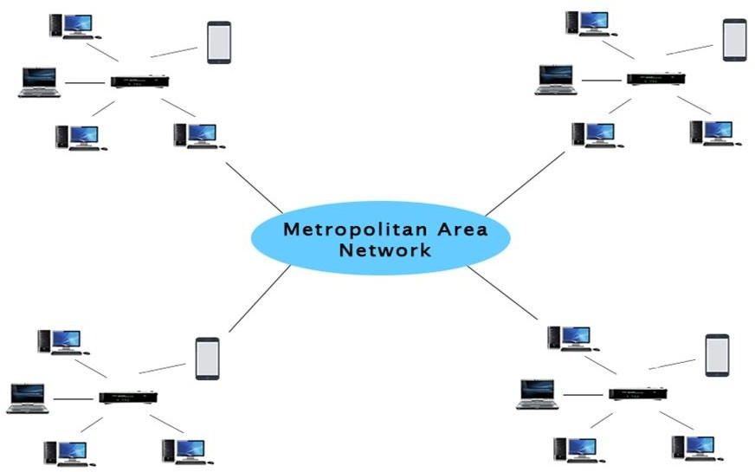
Metropolitan area network (MAN)

Slide 14
Wide area network (WAN)
A wide area network, or WAN, occupies a very large area, such as an entire country or the entire world.
A WAN can contain multiple smaller networks, such as LANs or MANs.
The Internet is the best-known example of a public WAN.

Slide 15
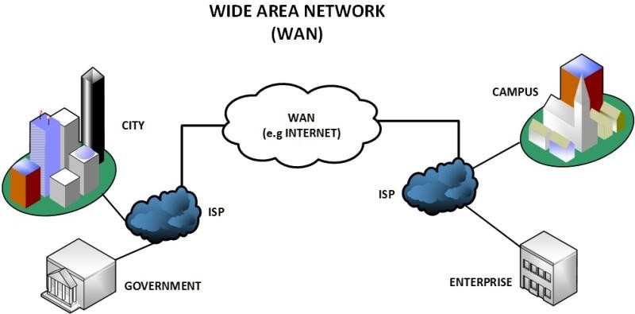
Wide area network (WAN)

Slide 16
Ethernet, Bluetooth, and Wi-Fi
16

Slide 17
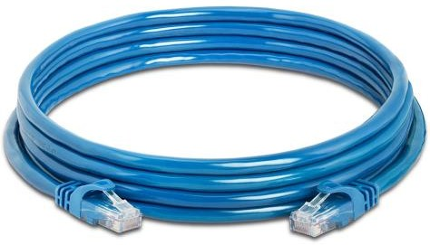
Ethernet
Ethernet is primarily a standard communication protocol used to create local area networks.
It transmits and receives data through cables.
This facilitates network communication between two or more different types of network cables such as from copper to fiber optic and vice versa.
17

Slide 18

Bluetooth
Bluetooth is a wireless technology that allows the exchange of data between different devices.
While Bluetooth uses wavelength to transmit information, it generally only works within a short distance for the devices to stay connected.
18

Slide 19
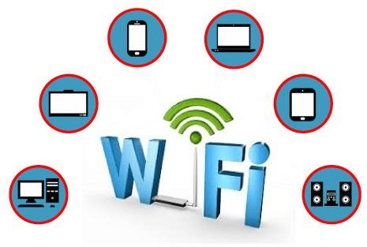
Wi-Fi
Wi-Fi is the wireless technology used to connect computers, tablets, smartphones and other devices to the internet.
Wi-Fi is the radio signal sent from a wireless router to a nearby device, which translates the signal into data you can see and use. The device transmits a radio signal back to the router, which connects to the internet by wire or cable.
19

Slide 20
Thank you!
Any Questions???
20

Slide 21
Network Architecture

Slide 22
Computer Network Architecture
Computer Network Architecture is defined as the physical and logical design of the software, hardware, protocols, and media of the transmission of data.
Simply we can say that how computers are organized and how tasks are allocated to the computer.
Client/Server network
Peer to peer Network
Point to point Network

Slide 23
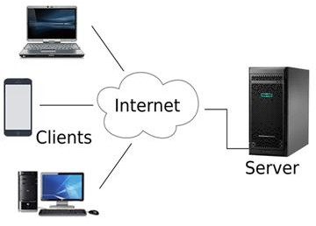
Client/Server Network

Slide 24
Client/Server Network
Client/Server network is a network model designed for the end users called
clients, to access the resources such as songs, video, etc. from a central computer known as Server.
The central controller is known as a server while all other computers in the network are called clients.
A server performs all the major operations such as security and network management.
A server is responsible for managing all the resources such as files, directories, printer, etc.
All the clients communicate with each other through a server. For example,
if client1 wants to send some data to client 2, then it first sends the request
to the server for the permission. The server sends the response to the client 1 to initiate its communication with the client 2.

Slide 25
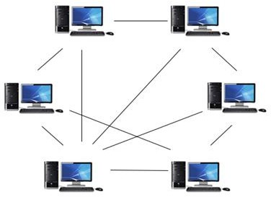
Peer-To-Peer Network

Slide 26
Peer-To-Peer Network
Peer-To-Peer network is a network in which all the computers are linked together with equal privilege and responsibilities for processing the data.
Peer-To-Peer network is useful for small environments, usually up to 10 computers.
Peer-To-Peer network has no dedicated server.
Special permissions are assigned to each computer for sharing the resources, but this can lead to a problem if the computer with the resource is down.

Slide 27
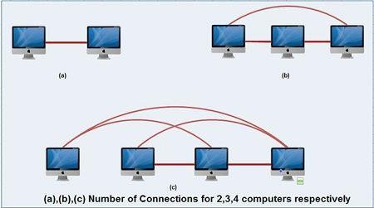
Point-To-Point Network

Slide 28
Point-To-Point Network
The point-to-point scheme provides separate communication channels for each pair of computers.
When more than two computers need to communicate with one another, the number of connections grows very quickly as number of computer increases.
Above figure illustrates that two computers need only one connection, three computers need three connections and four computers need six connections.

Slide 29
Network Topology

Slide 30
Network Topology
Network Topology refers to the layout of a network and how different nodes in a network are connected to each other and how they communicate.
Topologies are either physical (the physical layout of devices on a network) or logical (the way that the signals act on the network media, or the way that the data passes through the network from one device to the next).
Bus Topology
Ring Topology
Star Topology
Mesh Topology

Slide 31
Bus Topology
In networking a bus is the central cable (the main wire) that connects all devices on a local-area network (LAN).
It is also called the backbone.
This is often used to describe the main network connections composing the Internet.
Bus networks are relatively inexpensive and easy to install for small networks.
Ethernet systems use a bus topology.
Main Advantage: It's easy to connect a computer or device and typically it requires less cable than a star topology.
Main Disadvantage: The entire network shuts down if there is a break in the main wire and it can be difficult to identify the problem if the network
shuts down.
Designed by, Adil Khan 21

Slide 32
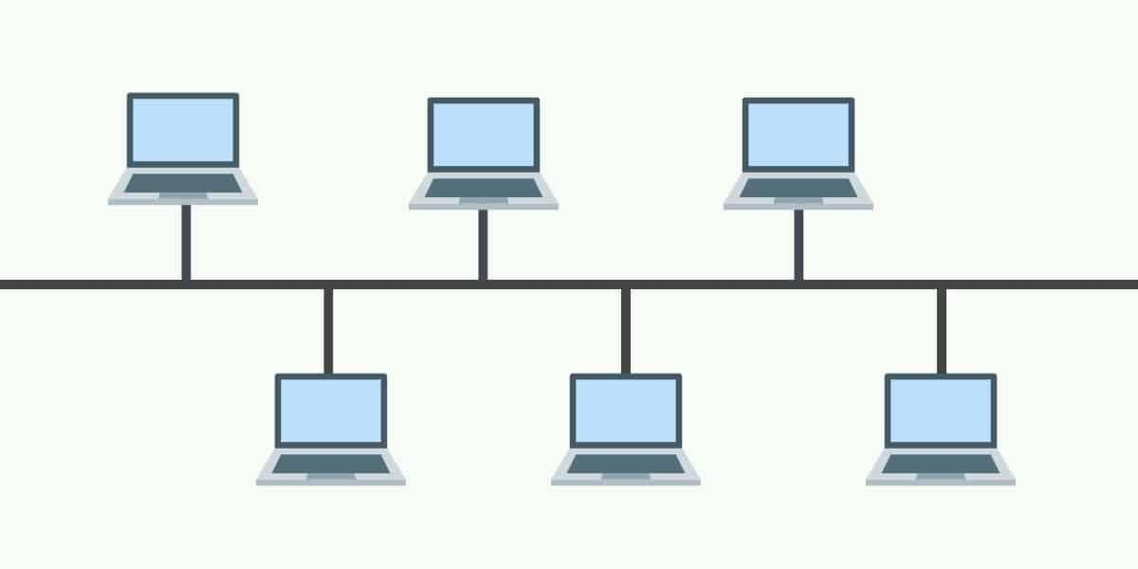
Bus Topology

Slide 33
Ring Topology
A local-area network (LAN) whose topology is a ring.
That is, all of the nodes are connected in a closed loop.
Messages travel around the ring, with each node reading those messages addressed to it.
Main Advantage: One main advantage to a ring network is that it can span larger distances than other types of networks, such as bus networks, because each node regenerates messages as they pass through it.

Slide 34
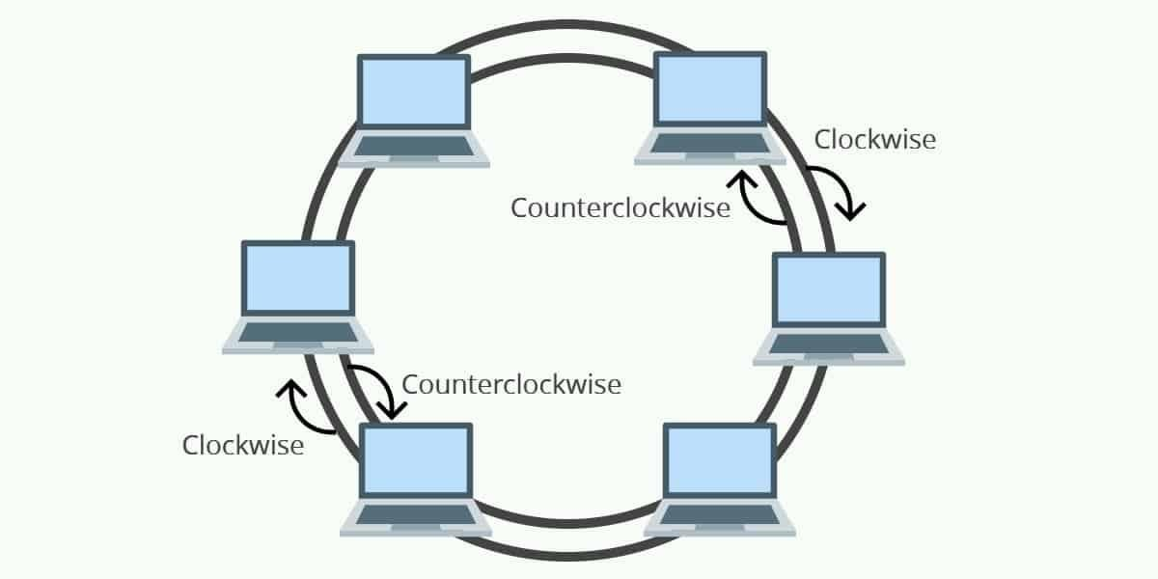
Ring Topology

Slide 35
Star Topology
In a star network devices are connected to a central computer, called a hub.
Nodes communicate across the network by passing data through the hub.
Main Advantage: In a star network, one malfunctioning node doesn't affect the rest of the network.
Main Disadvantage: If the central computer fails, the entire network becomes unusable.

Slide 36
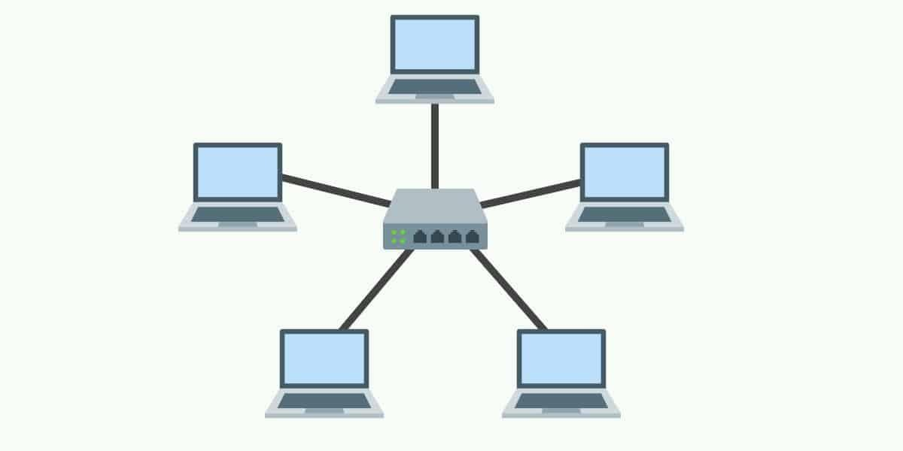
Star Topology

Slide 37
Mesh Topology
In a mesh network, devices are connected with many redundant interconnections between network nodes.
In a true mesh topology every node has a connection to every other node in the network.
There are two types of mesh topologies:
Full Mesh Topology
Partial Mesh Topology

Slide 38
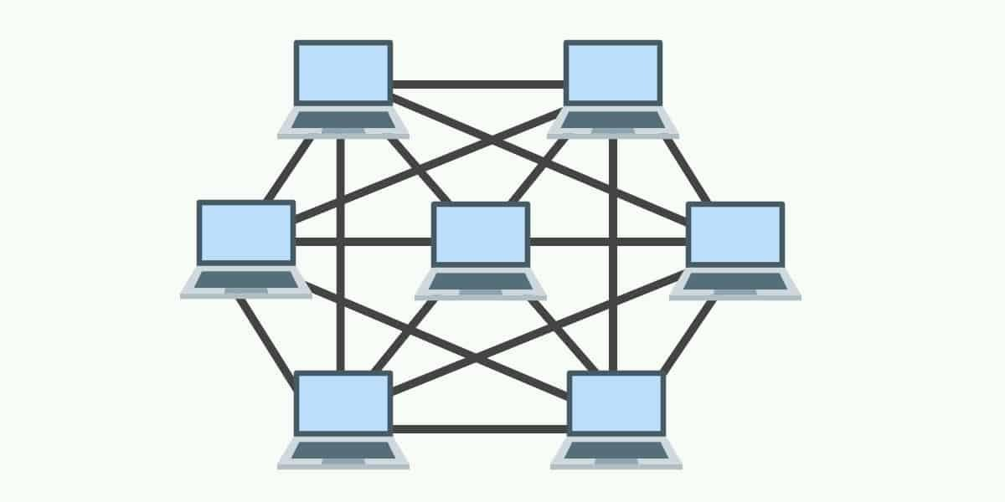
Mesh Topology

Slide 39
Network Devices

Slide 40
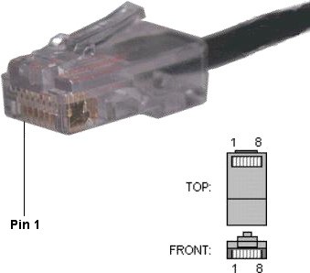
RJ-45 CONNECTOR
The Registered Jack-45 connector is commonly used for network
cabling and for telephony applications.
It is an eight wire connector which
is commonly used to connect computers
on the local area networks,
especially Ethernets.
It is similar to telephone
connector RJ-11 except that it has
eight wires as compared to 4 in RJ-11.

Slide 41


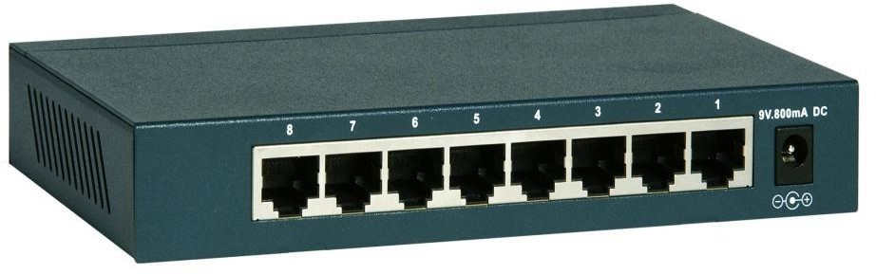
Switch
A switch is a network device which filters and forwards data packets across a network. A network switch is a computer networking device that connects network segments.
Network switches are capableof
inspecting data packets as they
are received, determining the source and destination device
of that packet andforwarding it appropriately.
Switches differ from hubs in that
they can have ports of different speed.

Slide 42
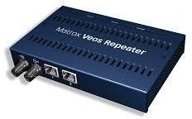
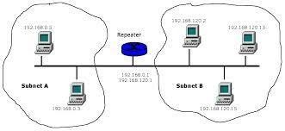
Repeater
It is a device that amplifies and restores a signal being transmitted on the network.
A repeater is an electronic device that receives a weak or low-level signal and retransmits it at a higher level or higher power, so that the signal can cover longer distances without degradation.
It is used in long network lines.

Slide 43

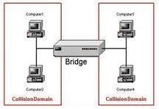

Bridge
It is network device which connects two or more local area networks (LANs) together.
In computer networks, a bridge is a device that connects a local area network (LAN) to another local area network that uses the same Hardware and software.

Slide 44

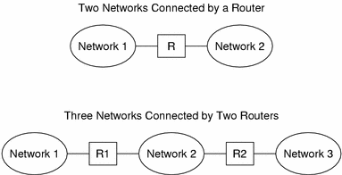
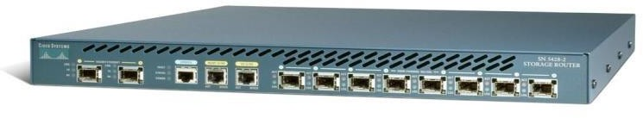
Router
Router is a specialized network device used to interconnect different types of computer network that uses different Hardware and software format.
A router can be used to connect
a Local Area Network (LAN) to another LAN,
a Wide Area Network (WAN) to another WAN,
Routers transmit data packets through these networks.

Slide 45
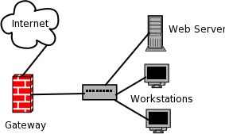
Gateway
A gateway is a network point that acts as an entrance to another network.
OR
A node on a network that serves as an entrance to another network.
A gateway can be Hardware software or both.
A router ,firewall and server can be work as gateway in computer network.

Slide 46
Transmission Modes
There are three modes of transmission simplex, half duplex, and full duplex.
Transmission mode describes the direction, of flow of signal between two connected devices.

Slide 47
Simplex
In simplex transmission mode, the communication between sender and receiver occurs in only one direction.
The sender can only send the data, and the receiver can only receive the data. The receiver cannot reply to the sender.
Simplex transmission can be thought of as a one-way road in which the traffic travels only in one direction—no vehicle coming from the opposite direction is allowed to drive through.
To take a keyboard / monitor relationship as an example, the keyboard can only send the input to the monitor, and the monitor can only receive the input and display it on the screen.
The monitor cannot reply, or send any feedback, to the keyboard.

Slide 48
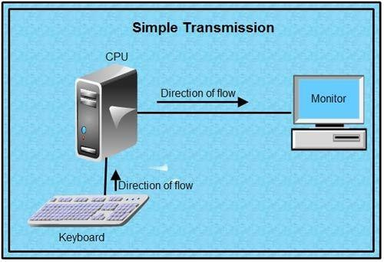
Simplex

Slide 49
Half-Duplex
The communication between sender and receiver occurs in both directions in half duplex transmission, but only one at a time.
The sender and receiver can both send and receive the information, but only one is allowed to send at any given time.
Half duplex is still considered a one-way road, in which a vehicle traveling in the opposite direction of the traffic has to wait till the road is empty before it can pass through.
For example, in walkie-talkies, the speakers at both ends can speak, but they have to speak one by one. They cannot speak simultaneously.

Slide 50
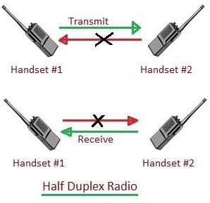
Half-Duplex

Slide 51
Full-Duplex
In full duplex transmission mode, the communication between sender and receiver can occur simultaneously.
The sender and receiver can both transmit and receive at the same time.
Full duplex transmission mode is like a two-way road, in which traffic can flow in both directions at the same time.
For example, in a telephone conversation, two people communicate, and both are free to speak and listen at the same time.

Slide 52
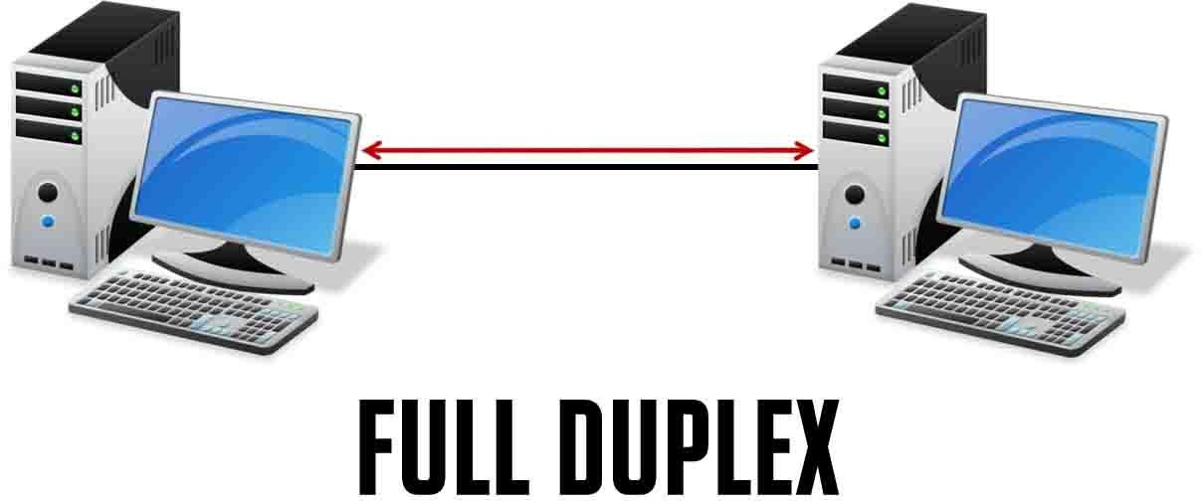
Full-Duplex

Slide 53
Difference
Basis of Comparison | Simple | Half Duplex | Full Duplex
Direction of Communication | Communication is unidirectional. | Communication is two- directional but, one at a time. | Communication is two directional and done simultaneously.
Send/Receive | A sender can send data but, can not receive. | A sender can send as well as receive the data but one at a time. | A sender can send as well as receive the data simultaneously.
Performance | The half duplex and full duplex yields better performance than the Simplex. | The full duplex mode yields higher performance than half duplex. | Full duplex has better performance as it doubles the utilization of bandwidth.
Example | Keyboard and monitor. | Walkie-Talkies. | Telephone.

Slide 54
Thank you!
Any Questions???

